Slide 1
Crop Classification in L-Band SAR Images
Guided By
Dr. Swati Jain

Slide 2
Outline
Types of satellite images
Optical Image
Hyperspectral Image
SAR Image
Difference between Optical image and SAR image
Hyperspectral imaging
Implementation of hyperspectral Image
Synthetic Aperture Radar Imaging
Why SAR is better than Optical and Hyperspectral
Types of Imaging Modes
Types of SAR Backscattering
Types of bands
Types of polarization
Why L band is better for crop classification
Satellites for L band SAR Image
ALOS Satellite
Types of Data provided by ALOS-PALSAR
Implementation
Future Work

Slide 3
Types of Satellite Image
Optical Image : An image formed by the refraction or reflection of light.
Hyperspectral Image : Hyperspectral imaging is the collecting and processing of information from across the electromagnetic spectrum(visible, near infrared).
SAR Image : A Synthetic Aperture Radar (SAR) is airborne or spaceborne side looking radar system which utilizes the flight path of the platform to generate high-resolution remote sensing imagery.

Slide 4
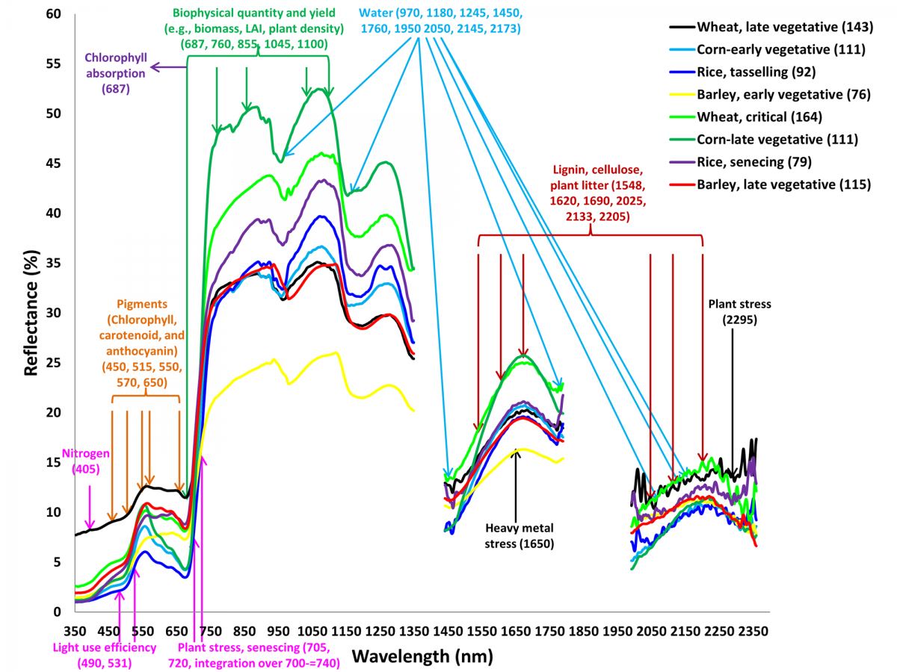
Different Types of vegetation signature [3]

Slide 5
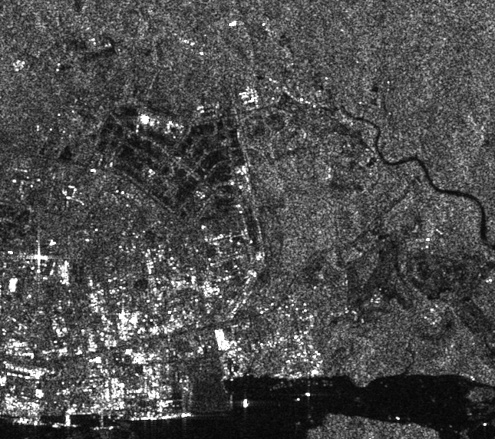
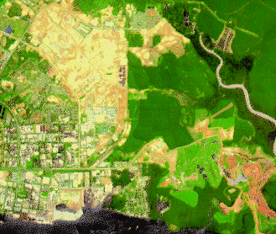
Difference between SAR Images and Optical Images
SAR Image [1]
Optical Image [1]

Slide 6
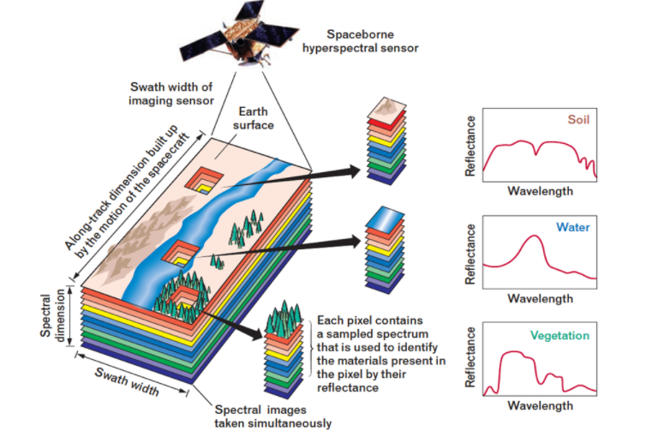
Hyperspectral Imaging
A simple analogy to understand the concept of hyperspectral imaging better- the human eye sees visible light in three bands, i.e. red, green, and blue whereas spectral imaging divides the spectrum into many more bands.
Hyperspectral imaging deals with the imaging of narrow spectral bands over a continuous spectral range.
The spectrum is a plot of wavelength versus reflectance.
Hyperspectral Image [2]

Slide 7
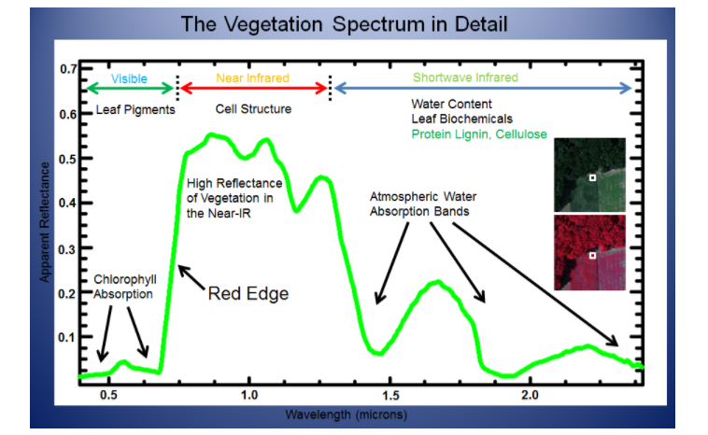
Spectral Signature of Vegetation
Spectral Signature [2]

Slide 8
Implementation of Hyperspectral Image

Slide 9
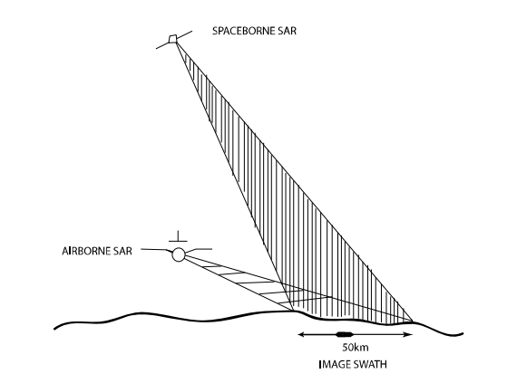
Synthetic Aperture Radar (SAR) Imaging
A Synthetic Aperture Radar (SAR), or SAR, is airborne or spaceborne side looking radar system which utilizes the flight path of the platform to generate high-resolution remote sensing imagery.
Radar System [4]

Slide 10
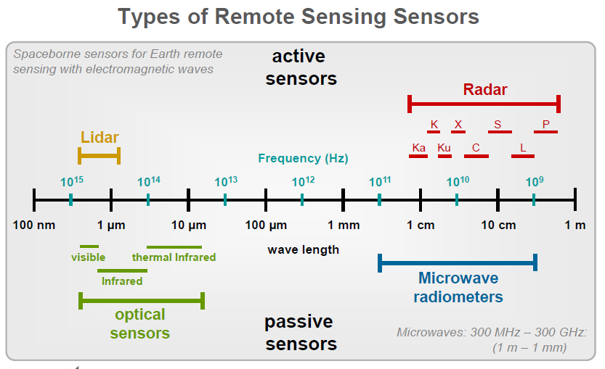
Electromagnetic Spectrum
Electromagnetic spectrum

Slide 11
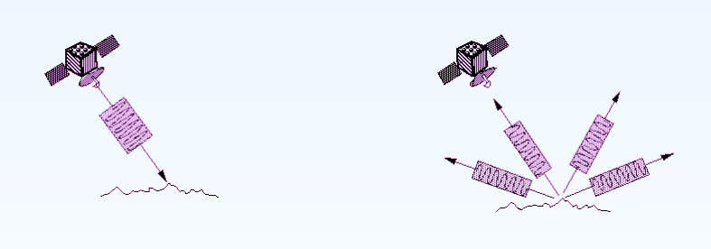
How SAR Works
(Transmit Signal) (Back Scattering)
By measuring the time delay between the transmission of a pulse and the reception of the backscattered "echo" from different targets, their distance from the radar and thus their location can be determined.

Slide 12
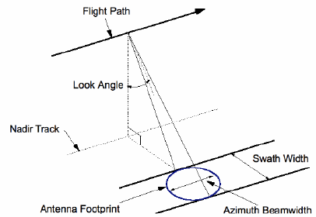
How SAR Generate Images
Typically, Synthetic Aperture Radar (SAR) produces a two-dimensional (2-D) image. One dimension in the image is called range and the other dimension is called azimuth and is perpendicular to range.

Slide 13
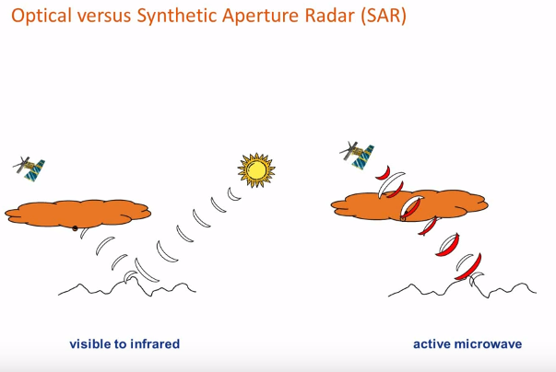
Why SAR is better than Hyperspectral and Optical Image
Active imaging (Independent of sun illumination)
All-Weather Imaging
Microwave imaging
The quick assessment of natural disasters
Subsurface penetration

Slide 14
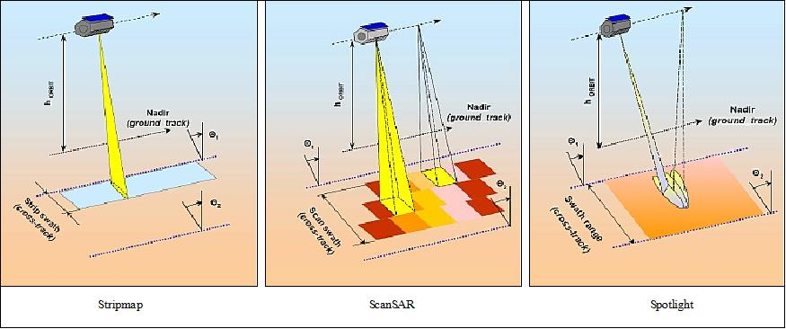
Types of Imaging Modes
Detection of coarse land cover features
Detection of infrastructure (roads)
Recognition of objects (airplanes, ships)

Slide 15
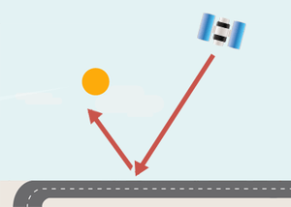


Types of SAR Backscattering
Single Bounce or rough surface scattering
Double Bounce or corner reflection
Volume Scattering, which can also be multipath propagation
Single Bounce
Double Bounce
Volume Scattering

Slide 16
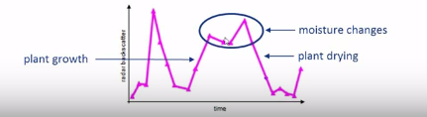
What does synthetic Aperture Radar Measure?
Roughness: The higher the object’s roughness, the larger fraction of energy reflected back to the radar.
Moisture: The moisture content in the plant translates into relevant variations of the backscattered energy.

Slide 17
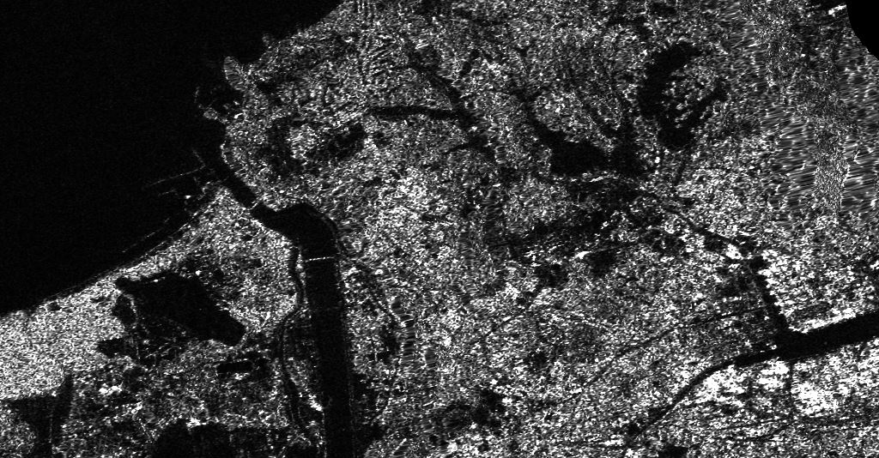
VOLUME SCATTERING
DOUBLE BOUNCE
SURFACE
Backscattering [6]

Slide 18
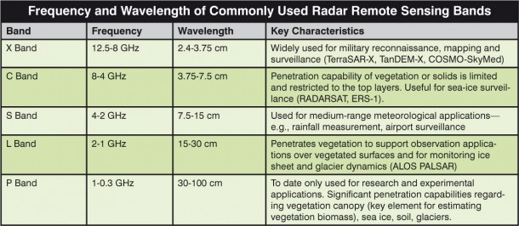
Types of Bands

Slide 19
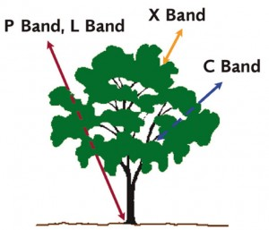
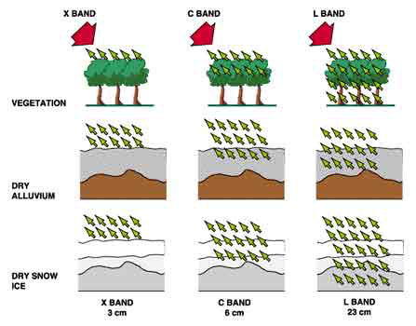
Types of Bands

Slide 20
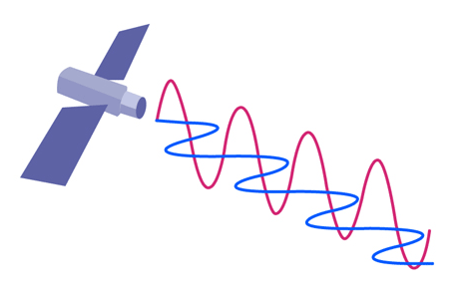
Types of polarization
Single polarization. The radar system operates with the same polarization for transmitting and receiving the signal. (HH or VV)
Cross polarization. A different polarization is used to transmit and receive the signal. (HV or VH)
Dual polarization. The radar system operates with one polarization to transmit the signal and both polarizations simultaneously to receive the signal.
Quad polarization. H and V polarizations are used for alternate pulses to transmit the signal and with both simultaneously to receive the signal.

Slide 21
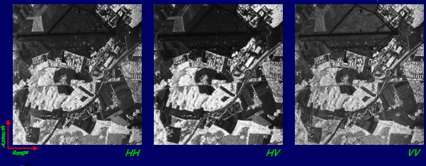
Comparison of Polarizations

Slide 22
Overview of Different SAR Missions
# | SAR Mission | Band Used | Advantage | Disadvantage | Reference
1 | TerraSAR-X | X Band | Easily identify military movements | It can not identify small military objects like drones | [7] [11]
2 | RADARSAT-1 | C Band | It can penetrate to the top layer of the vegetation | Can not penetrate in forest area | [8]
3 | ALOS PALSAR | L Band | Penetrates vegetation, ice sheet | Can not use to find soil moisture | [9] [12]
4 | NISAR | L & S Band | Easily identify type of vegetation | - | [10]

Slide 23
Why L band is better for crop classification
L band signal can penetrate more compare to X and C bands.
Intermediate layers like cloud and forest does not affects the penetration.

Slide 24
Different Format of SAR Data
RAW : SAR signal reflected from one single point is spread along both azimuth and range. Signal data cannot be viewed as an image.
Single Look Complex (SLC) : Each pixel gives a complex number that carries amplitude and phase information about the microwave field backscattered.
Multilook : Due to slant near-range appear compressed relative to far-range. Multilooking is the process in which square pixels are generated.
Geocoded : Reference the latitude and longitude
Polarimetric
Single (HH or VV)
Dual (HH+HV or VV+HV)
Quad (HH+HV+VH+VV)

Slide 25
Satellites for L band Image
SAR SATELLITE MISSIONS | OWNER | LAUNCH DATE (PLANNED) | APPLICATION
ALOS PALSAR | JAXA | JANUARY 2006 | Geometric calibration and validation and radiometric calibration, Improvement of analysis method utilizing microwave scatter
SAOCOM(SIASGE) | CONAE | OCTOBER 2008 | Management of emergencies or natural disasters and monitoring of natural resources.
NISAR | NASA-ISRO | MAY 2021 | Soil moisture monitoring Crop monitoring Natural disaster

Slide 26
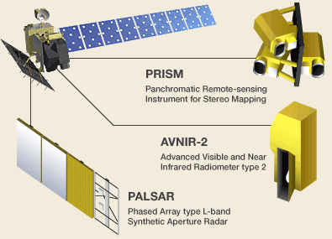
ALOS Satellite
The Advanced Land Observing Satellite (ALOS) is a satellite developed by the Japan Aerospace Exploration Agency (JAXA) and contains 3 sensor types:
Panchromatic Remote sensing Instrument for Stereo Mapping (PRISM)
Advanced Visible and Near Infrared Radiometer type 2 (AVNIR-2)
Phased Array type L-band Synthetic Aperture Radar (PALSAR)

Slide 27
ALOS-PALSAR
PALSAR is an active microwave sensor using L-band frequency and has various products of different resolutions and performance.
The products being offered are:
Fine Beam Single (FBS) Mode – Uses HH or VV polarization and has the highest spatial resolution than the other modes. This mode is offered with a spatial resolution of 10m.
Fine Beam Dual (FBD) Mode – Uses HH and HV or VV and VH polarization and has a slightly lower resolution than Fine Beam Single Mode. This mode is offered with a spatial resolution of 16m.
Polarimetric (PLR) Mode – Uses all polarization modes, HH, HV, VV, and VH. The spatial resolution of this mode is the lowest of all other modes with a spatial resolution of 25m.

Slide 28
Types of data provided by ALOS-PALSAR
1. Fine Mode, Single Polarization(FBS)
1.1 FBS_L11 ( .1__D)
1.2 FBS_L15 ( .5_UD)
2. Fine Mode, Dual Polarization(FBD)
2.1 FBD_L10 ( .0__D)
2.2 FBD_L11
2.3 FBD_L15R (Geo-reference) ( .5_UD)
2.4 FBD_L15G (Geo-coded) ( .5GUD)
3. Polarimetric Mode, 4 Polarization(PLR)
3.1 PLR_L11 ( .1__A )
3.2 PLR_L15 ( .5_UA)

Slide 29
Processing Stages
Parameters
Leader
Data File
Parameters
Input appropriate number of looks
Parameters
Reduce noise
1. ALOS PALSAR import and focusing
Single Look Complex (SLC)
2. Focusing and multilooking
Intensity Image
3. Conventional Despekling
Raw PALSAR Level 1.0 Data
8 bit and 32 bit Greyscale GeoTiff
Save as GeoTiff
Geocoded Images
4. Geocoding and Radiometric Calibration
Filter Image
Parameters
DEM
Grid Size
Nearest Neighbour Resampling Method

Slide 30
Implementation of ALOS-PALSAR Image

Slide 31
Study site and Data used
The study area has centre latitude 33.816700 and longitude 130.628100. It covers some area of Japan. The acquisition Date is 01 July 2006. The dataset used for classification is ALPSRP023120670. The analysis region is primarily composed of five distinct land cover classes. Specifically urban, water, bare soil, short vegetation and tall vegetation.

Slide 32
Original Images
HH
HV
VH
VV

Slide 33
Process for Classification
Decision tree approach requires thorough knowledge of information bearing features and their physical understanding.
It has been already known that backscattering is a function of the electromagnetic wave parameters such as wave frequency, its polarization, its incidence angle, it depends on the target characteristics such as surface geometry, physical property.
The objective of the present work is to extract physical information from backscattering behaviour of various objects.

Slide 34
Process for Classification
The analysis is based on polarised backscattering coefficients measured at HH, VV, HV, HH/VV, HV/VV. These standard polarimetric features act as our information bearing features for predicting the nature of target.
Above mentioned all polarized backscatter coefficients were calculated for each class such as urban, water, short vegetation, tall vegetation and bare soil.
In order to make decision boundaries for separation of various classes, the concept of feature separation has been used.
The measure, called separability index for class pair separation.

Slide 35
Calculate Separability Index
……………….[5]
where µ and σ are mean values and standard deviations, respectively of classes i and j for a particular feature.
S_{ij} lies in between 0.8 to 1.5, which indicates an authentic feature for separation of two classes i and j.
Two classes will be well separated by a particular feature if the difference between the mean values of two classes is large as compared to the sum of standard deviations of those classes.
S_{ij} = |µ_{i} - µ_{j}|/ σ_{i} + σ_{j}

Slide 37
Decision Tree For Classification
Water, Urban, Tall Vegetation, Bare Soil, Short Vegetation
Urban, Tall Vegetation, Bare Soil, Short Vegetation
Water
Bare Soil, Short Vegetation
Urban, Tall Vegetation
Unclassified, Short Vegetation
Bare Soil
Tall Vegetation
Urban
Unclassified
Short Vegetation

Slide 38
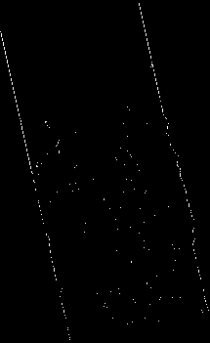

Slide 39
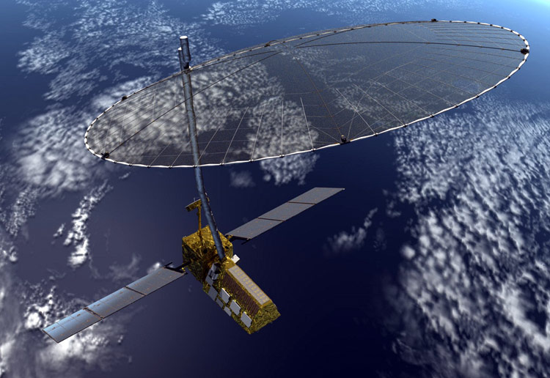
Future Work
Work on NASA-ISRO SAR mission (NISAR) Dataset.
NISAR SATELLITE [6]

Slide 40
References
https://crisp.nus.edu.sg/~research/tutorial/sar_int.htm
http://www.markelowitz.com/Hyperspectral.html
https://eros.usgs.gov/doi-remote-sensing-activities/2012/hyperspectral-remote-sensing-vegetation-knowledge-gain-and-knowledge-gap-after-40-years-research
S. Gupta, S. Kumar, A. Garg, D. Singh, and N. Rajput, “Class wise optimal feature selection for land cover classification using sar data," in Geoscience and Remote Sensing Symposium (IGARSS), 2016 IEEE International, pp. 68{71, IEEE, 2016.http://learningzone.rspsoc.org.uk/index.php/Learning-Materials/Radar-Imaging/Image-Interpretation-Polarisation
P. Mishra, D. Singh, and Y. Yamaguchi, “Land cover classification of palsar images by knowledge based decision tree classier and supervised classifiers based on sar observables," Progress In Electromagnetics Research B, vol. 30, pp. 47-70, 2011.
https://nisar.jpl.nasa.gov/
http://ieeexplore.ieee.org/document/5356148/
https://www.researchgate.net/publication/259562760_Assessment_of_L-Band_SAR_Data_at_Different_Polarization_Combinations_for_Crop_and_Other_Landuse_Classification

Slide 41
Thank You…

